Slide 1
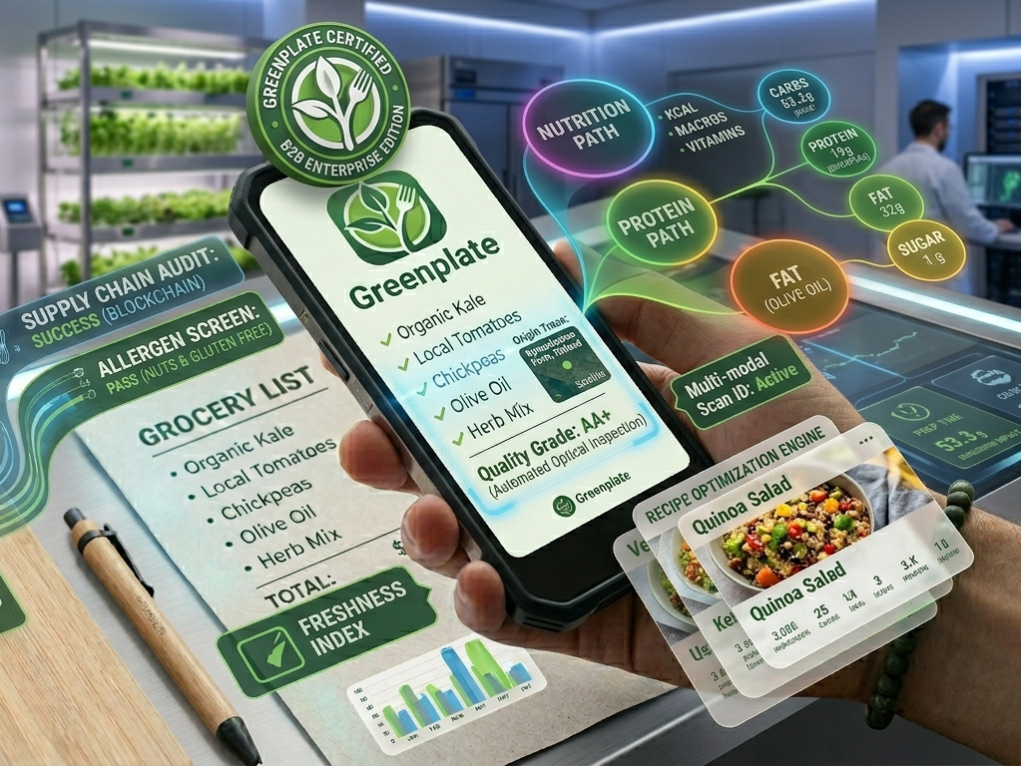
GREENPLATE
The Intelligent Pantry Assistant Scan. Track. Cook. Save.

Slide 2
The Concept 💡
A mobile-first solution designed to bridge the gap between 'guilt' and 'action’.
By replacing manual data entry with AI-powered scanning, we make sustainable living as easy as taking a photo.

Slide 3
The Problem
Invisible Waste
Items forgotten at the back of shelves.
Entry Fatigue
Manual tracking is too time-consuming.
Expiry Anxiety
Uncertainty about safe consumption dates.
Financial Loss
Average household wastes ~€500 annually.

Slide 4
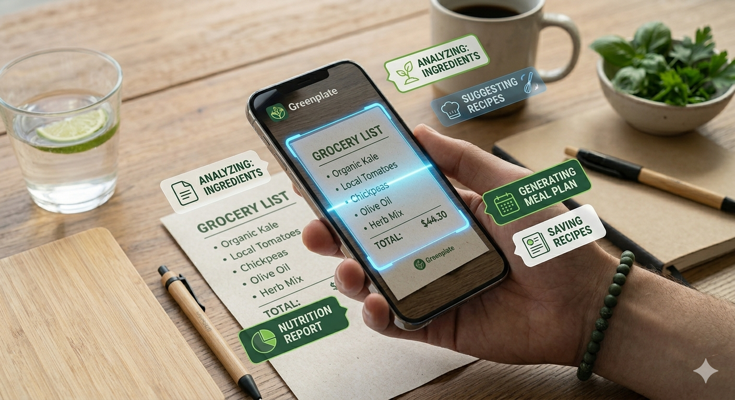
Enhanced Features
One-Tap OCR
Instant digital inventory from paper receipts.
Smart Fridge View
Visual color-coded expiry alerts.
AI Recipe Engine
Uses expiring items to suggest tonight's dinner.
Eco-Impact Score
Track CO2 and money saved in real-time.

Slide 5

Modern Tech Stack (Tools)
Flutter
Firebase (Secure Cloud Sync)
Google ML Kit (Precision Scanning)
OpenAI (Smart Recipes)
FCM: Firebase Cloud Messaging (Timely Alerts)

Slide 6
Target & Future Impact
• Primary: Busy households looking to save money.
• Secondary: Eco-conscious users reducing carbon footprint.
• Future: B2B partnerships with local grocery chains.
• Goal: Reducing Finland's food waste by 10% in 3 years.

